Slide 1

GAME DEV SIM
A SIM ABOUT GAME DEV…

Slide 2
WATER WARS LIQUID ASSAULT
2 player PvP top down arena shooter with water pistols
Various other liquids you can collect as ammo
Acid - does double damage
Tar - slows opponent
Alcohol - reverses opponent controls
Toxic Waste - does damage over time (poison)

Slide 3
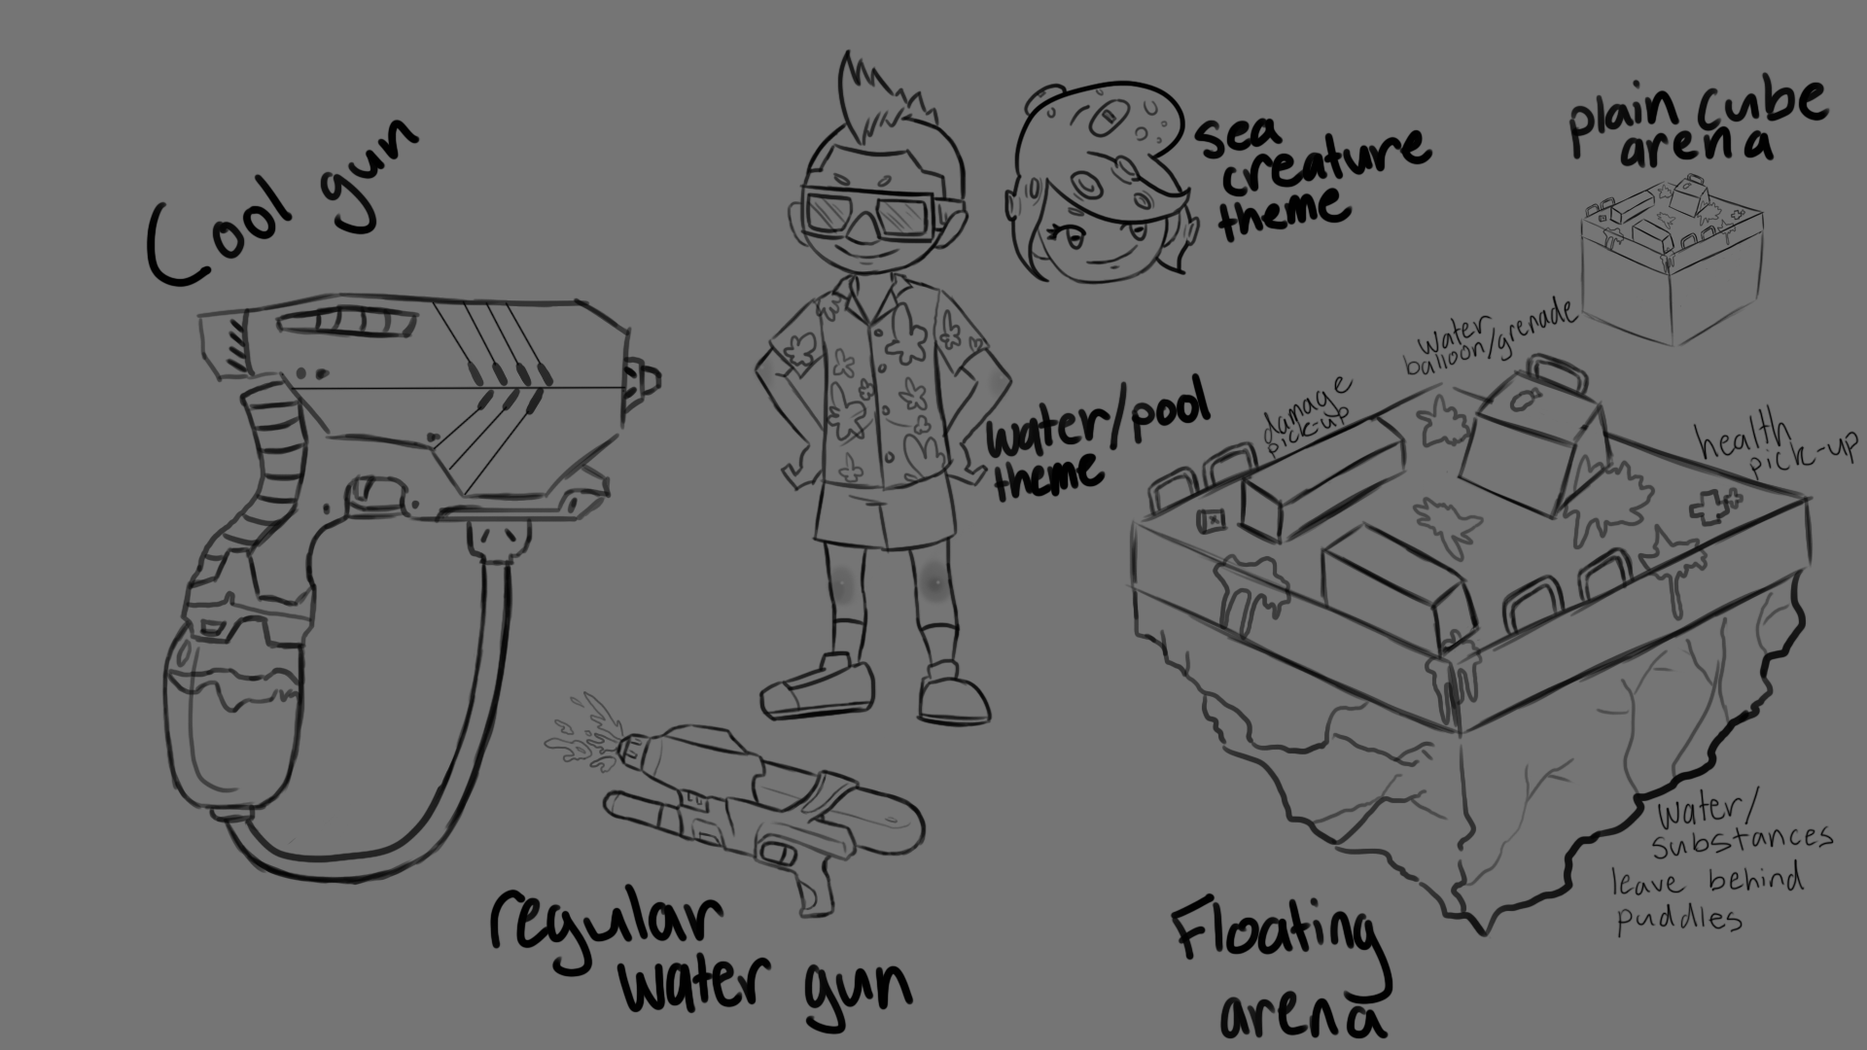

Slide 4
WATER WARS
Simple controls that are easy to learn
Single screen PvP gameplay
Start with creating the basic gameplay and add more features depending on time (grenades, environment effects)
Stylized Graphics

Slide 5
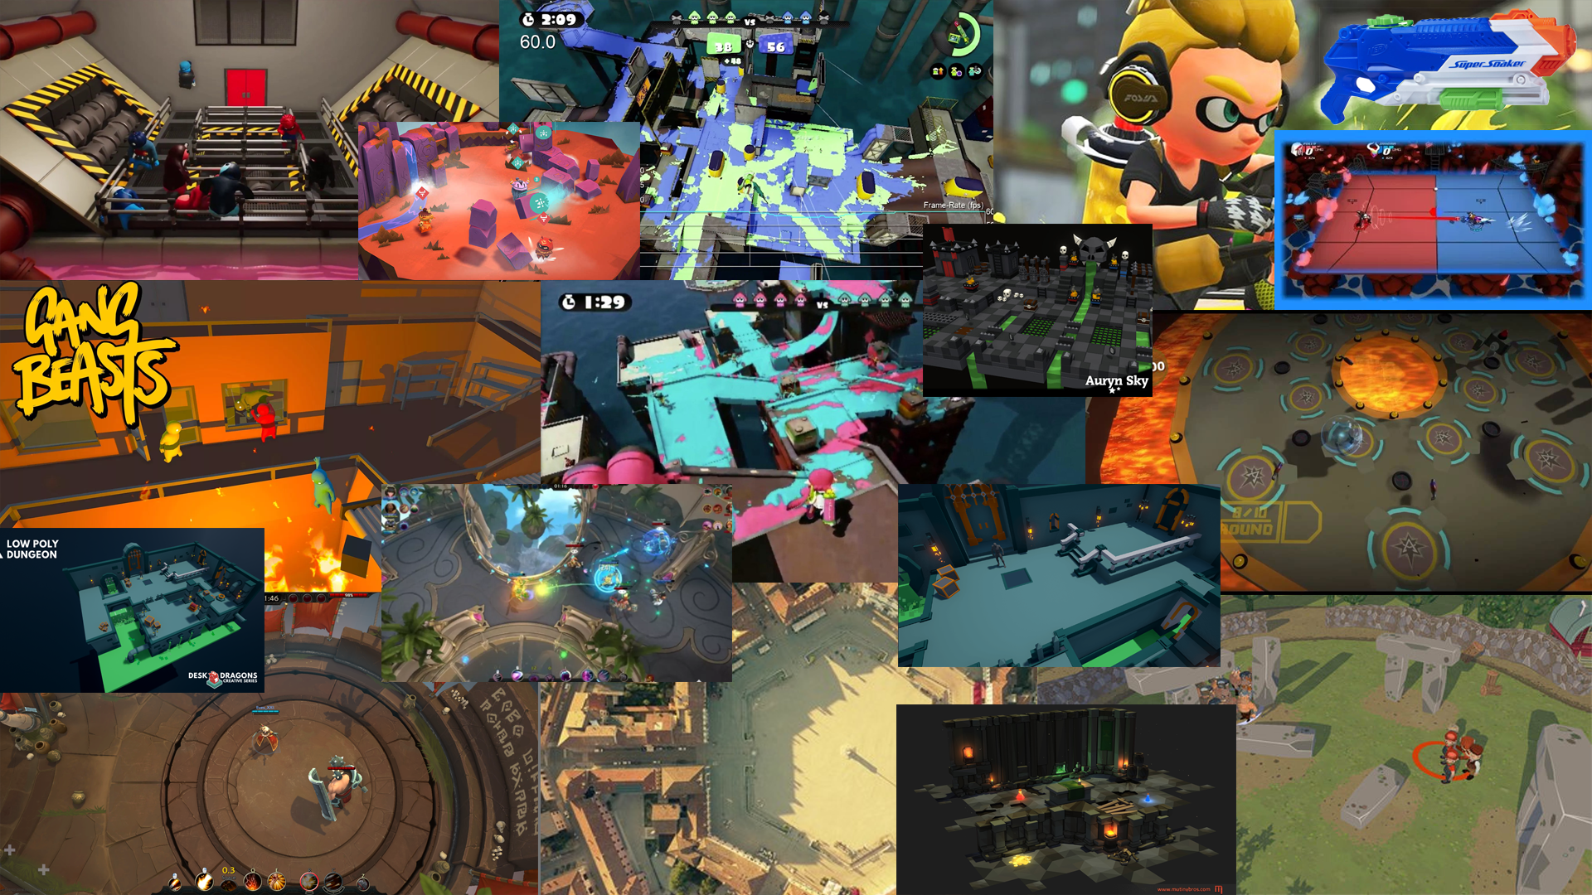

Slide 6
HOUSE OF HORROR
Atmospheric horror game/walking sim where the player must escape from a cult’s house
Player wakes up in the basement after being drugged
They have a memory of being kidnapped
They find candles to light their way

Slide 7
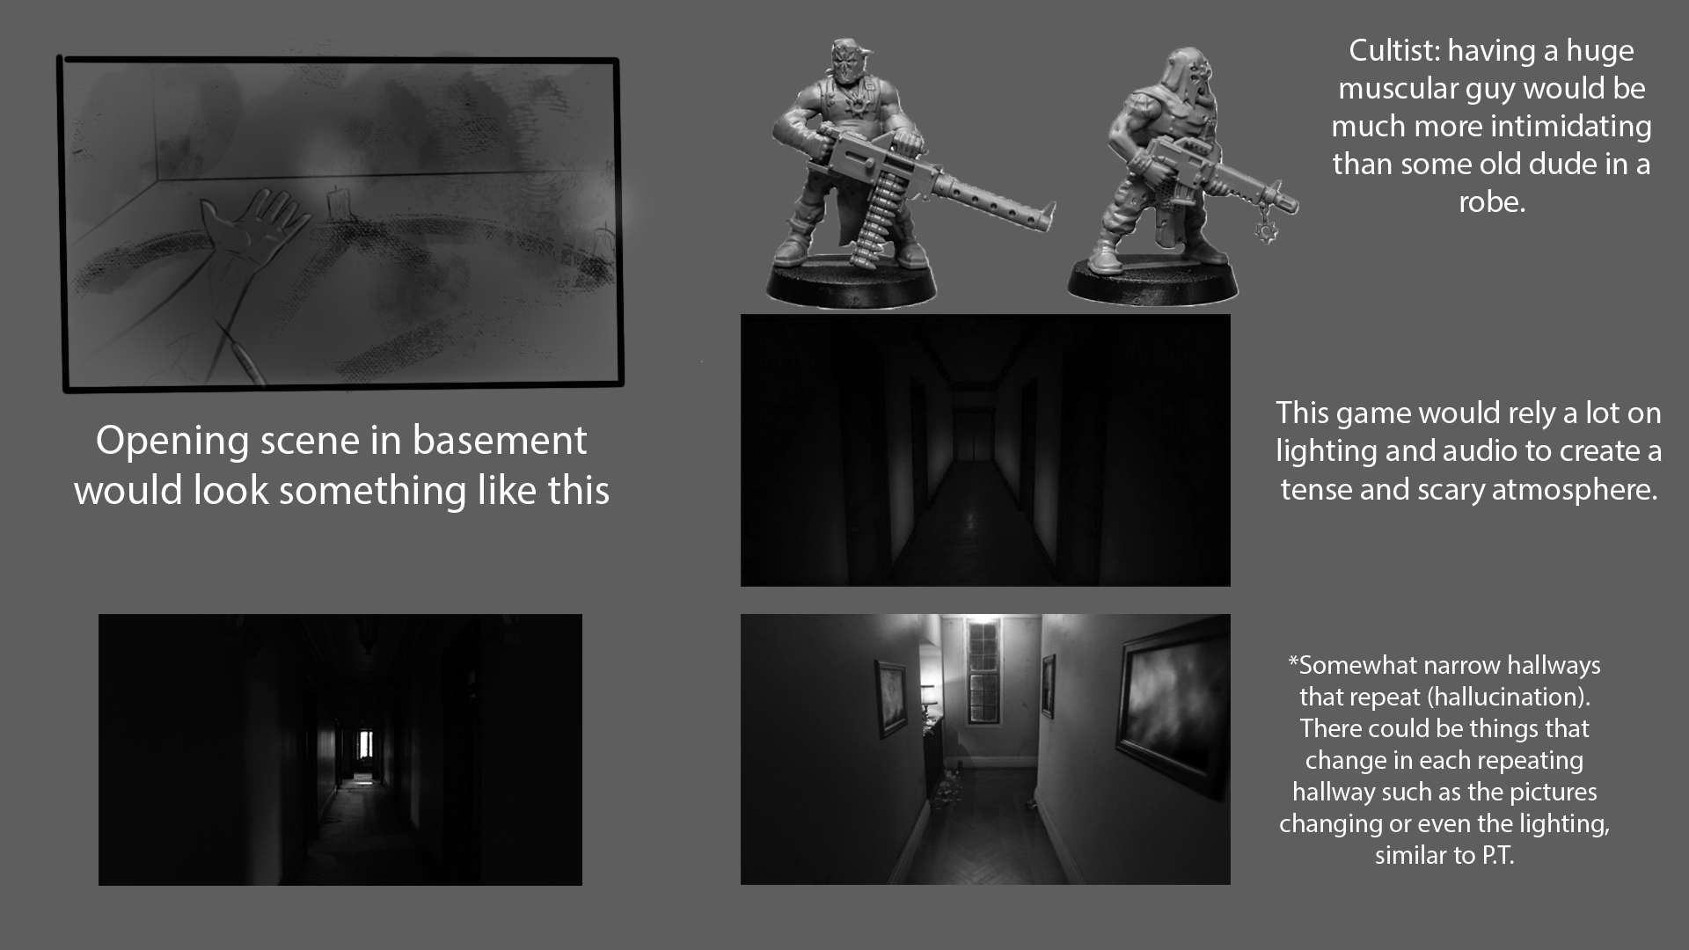

Slide 8
HOUSE OF HORROR
Distinct experiences - visual and auditory hallucinations making the player questioning what is real
Atmosphere - due to the low light levels and the ominous sound effects
Environmental storytelling and static single framed cutscenes
Resource management - limited light sources available to player

Slide 9
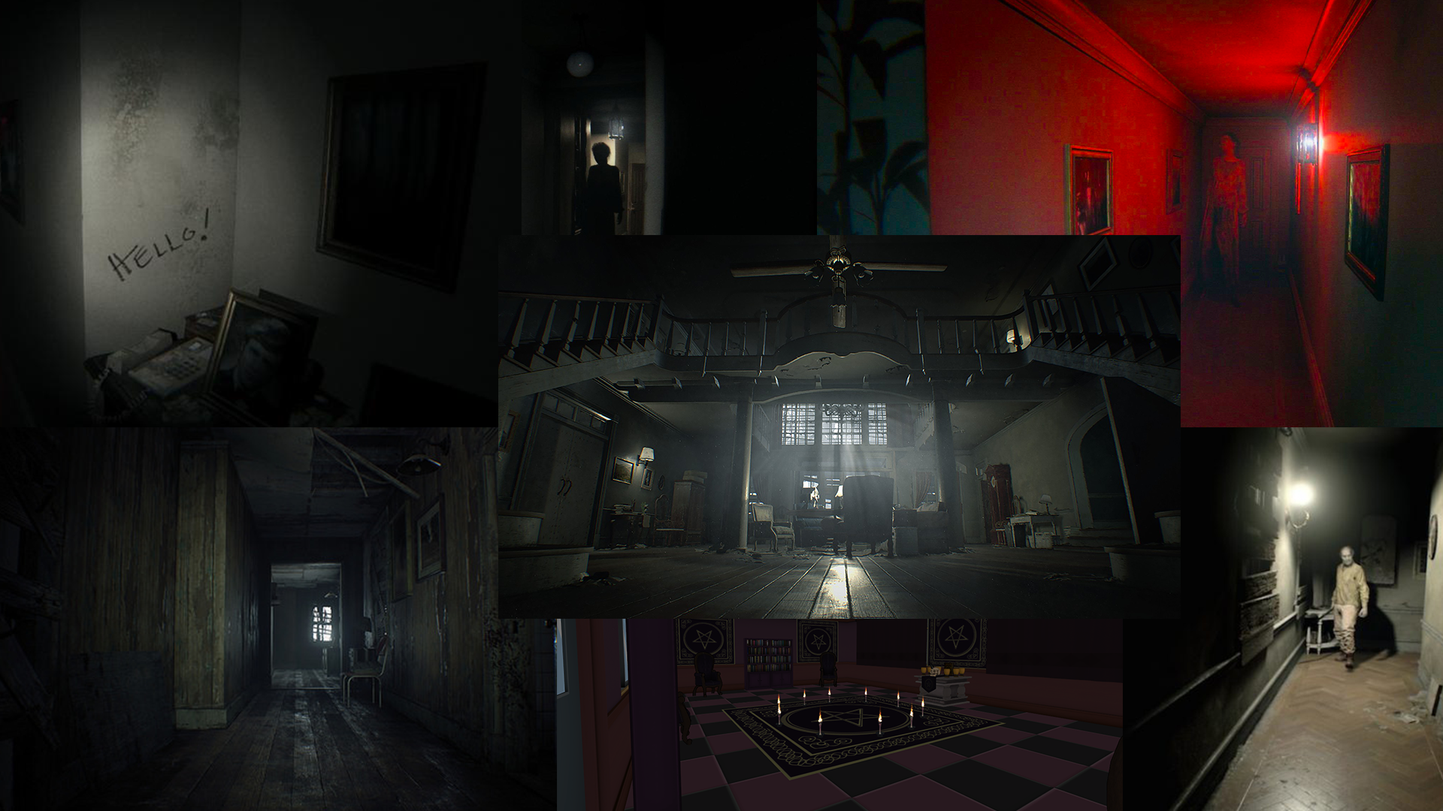

Slide 10
THIEF IN THE NIGHT
Top down 3D stealth game where the player is a cat burglar
Skulk about in other people’s homes as they sleep
Tread carefully to not alert them to your presence, keep people outside of your noise proximity metre
Get the loot and get out before morning (time limit)

Slide 11
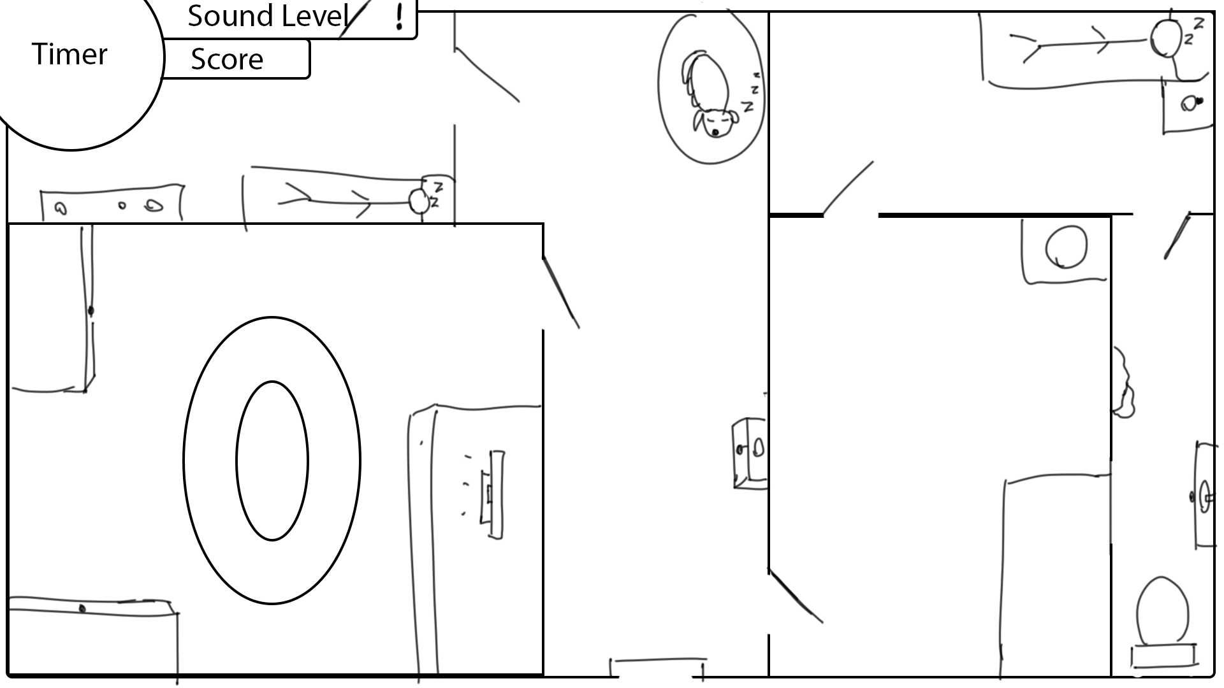

Slide 12
THIEF IN THE NIGHT
Risk versus reward most valuable items are the hardest to access
Increased difficulty that escalates as you progress through the game
Single screen maps
Modular level design can easily be rearranged to create new layouts
Sound mechanics - the more items you carry, the bigger your noise proximity becomes

Slide 13
